Slide 1
Faulting Lines
Yucong Pan
Pan311@purdue.edu

Slide 2
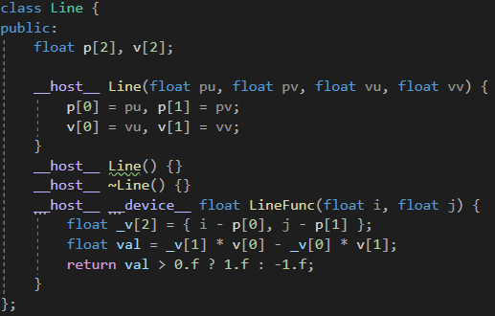
Implementation
Host: declare a vector of Line, iterate all of lines for each point on height map, increase/decrease the value depending it’s on the left/right side of a line.
Device: Use an array of Line stored in constant memory. The rest is same.

Slide 3
Analysis
n | 256 | 512 | 1024 | 2048
CPU | 67.3 | 110.7 | 243.3 | 567.2
CPU_MP | 29.1 | 42.3 | 76.1 | 152
GPU | 2.5 | 3 | 3.4 | 3.9

Slide 4
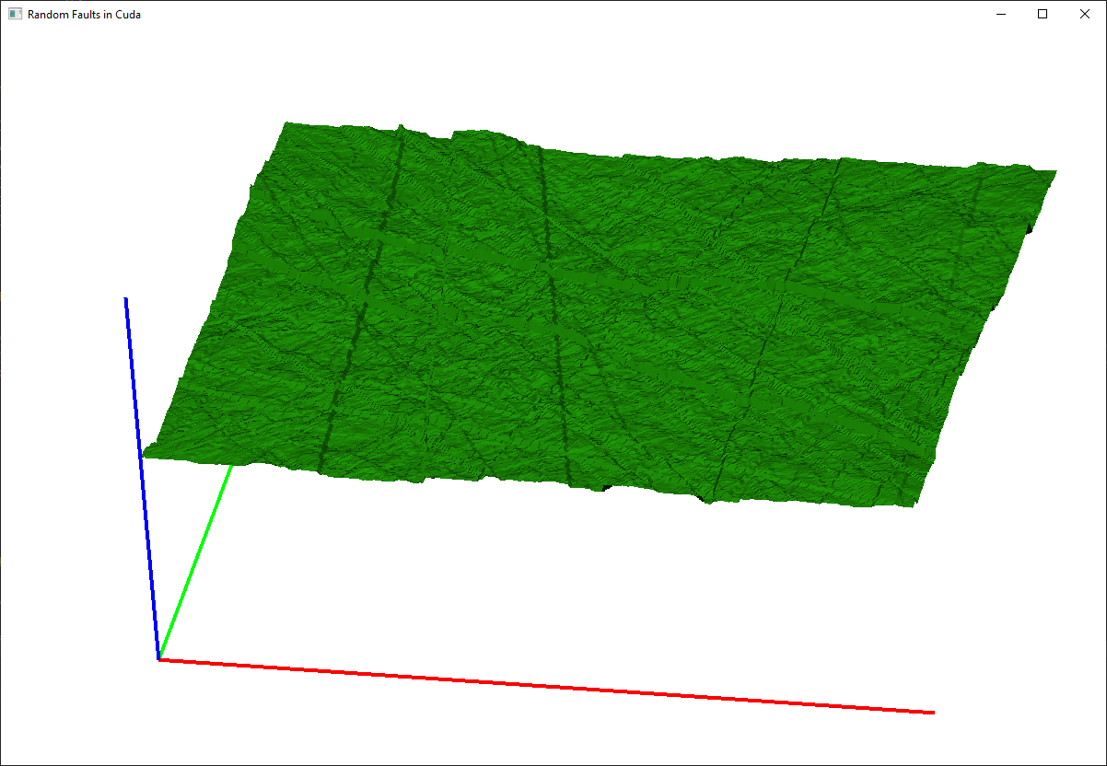
Discussion
GPU and constant memory is sooooooooooo fast.
The first call to GPU is slow (lazy initialization)

